Slide 1
Natural language processing evaluation metrics

Slide 2
Unit objectives
Define various metrics to measure the quality of NLP algorithms.
Explain the difference between these metrics.

Slide 3
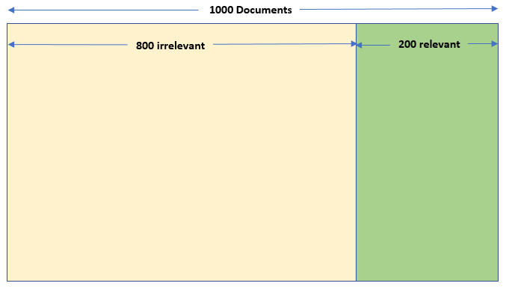
System evaluation
How can we measure the solution quality?
Target: You developed a new search engine. You must define how well it works.
Notes:
How can we measure the solution quality? In this presentation, we focus on a basic metric to evaluate system performance in information retrieval. Assume that you developed a search algorithm that helps you to retrieve related words from a corpus that contains 1000 documents.
From these 1000 documents, assume 200 are relevant to the word cat, and the other 800 documents are irrelevant.

Slide 4
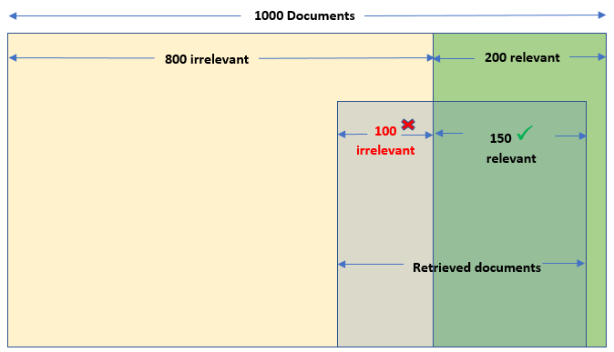
System evaluation (cont.)
You ran a search test for the word “cat”.
After the test ran, the search engine retrieved the documents that are shown here.
Notes:
You test your solution by searching for the word “cat”. Your algorithm returns 250 documents, where 150 documents are relevant (which means your algorithm missed 50 relevant documents) and 100 documents are irrelevant (which means your algorithm correctly eliminated 700 of the irrelevant documents).

Slide 5
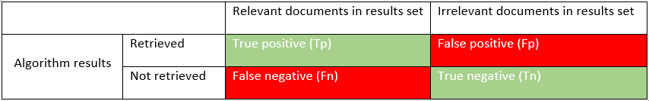
System evaluation (cont.)
Confusion matrix
How many relevant documents were retrieved by the algorithm? 150 documents → True positive (Tp).
How many irrelevant documents were retrieved by the algorithm? 100 documents → False positive (Fp) (total 250 documents retrieved – 150 relevant documents).
How many relevant documents did the algorithm not retrieve? 50 documents → False negative (Fn).
How many irrelevant documents did the algorithm not retrieve? 700 documents → True negative (Tn).
Notes:
A confusion matrix, also known as an error matrix, is a specific table layout that enables visualization of the performance of an algorithm.
Based on the results for this example, how many relevant documents were retrieved by the algorithm? The answer is 150 documents. This value is the True positive (Tp).
Based on the results for this example, how many irrelevant documents were retrieved by the algorithm? The answer is 100 documents (total 250 documents retrieved – 150 relevant documents). This value is the False positive (Fp).
Based on the results for this example, how many relevant documents did the algorithm not retrieve? The answer is 50 documents. This value is the False negative (Fn).
Based on the results for this example, how many irrelevant documents did the algorithm not retrieve? The answer is 700 documents. This value is the True negative (Tn).
The objective is to improve the algorithm to decrease the Fp and Fn values.

Slide 6
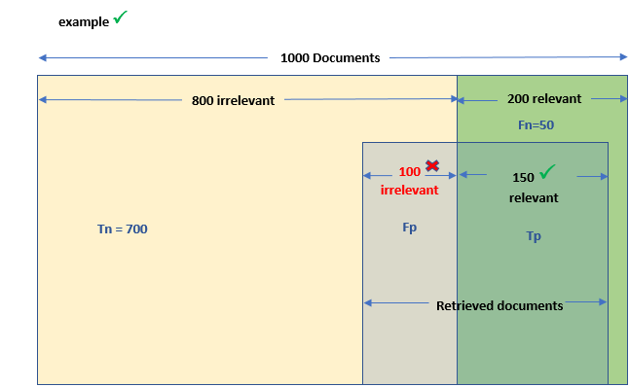
System evaluation (cont.)
Notes:
We map the confusion matrix to the graph to produce the visuals for Tp, Fp, Tn, and Fn. We add Tp to the retrieved relevant documents area and Fp to the retrieved irrelevant area. We add Fn to the not retrieved relevant area and Tn to the not retrieved irrelevant area.

Slide 7
System evaluation (cont.)
Accuracy
Calculates how many correct results your solution managed to identify.
Apply the formula to the example.
Useful for symmetric data sets where the values of positive and negatives are almost the same.
Accuracy = (Tp+Tn)/(Tp+Tn+Fp+Fn)
Accuracy = (150+700)/(1000)
Notes:
Accuracy is as a numeric measure of how good your algorithm is. It calculates how many correct results your solution managed to identify, which is the proportion of true results among the total number of cases that are examined.
Accuracy is defined by the following formula, which includes the Tp, Tn, Fp, and Fn metrics:
Accuracy = (Tp+Tn)/(Tp+Tn+Fp+Fn)
By applying the values from the example, accuracy can be calculated as follows:
Accuracy = (150+700)/1000 = 0.85
Accuracy is a good measure but only when you have symmetric data sets where the number of positive values and negatives values are almost the same. For example, if your data set is split as 90 positive samples and 10 negative samples, classifying all as positive gives a 0.90 accuracy score.
Therefore, we must look at other metrics such as precision and recall to evaluate the quality of the algorithm.

Slide 8
System evaluation (cont.)
Precision
Represents the fraction of retrieved documents that are relevant.
Apply the formula to the example.
Precision = Tp/(Tp+Fp)
Precision = 150/(150+100) Precision = 150/250 = 0.60
Notes:
Precision is a numeric measure that represents the fraction of retrieved documents that are relevant. It is defined by the following formula:
Precision = Tp/(Tp+Fp)
Apply the formula to the example:
Precision = 150/(150+100)
150 retrieved relevant / 250 total retrieved = 0.60

Slide 9
System evaluation (cont.)
Recall
Represents the fraction of relevant documents that were retrieved.
Apply the formula to the following example.
Recall = Tp/(Tp+Fn)
Recall = (150)/(150+50)
Recall = 150/200 = 0.75
Notes:
Recall is a numeric measure that represents the fraction of relevant documents that were retrieved. It is defined by the following formula:
Recall = Tp/(Tp+Fn)
Apply the formula to the example:
Recall =150/(150+50)
150 retrieved relevant / 200 total relevant = 0.75

Slide 10
System evaluation (cont.)
F-Score (F-measure)
Enables you to tradeoff precision against recall.
The higher the F-score value is, the better the algorithm is.
Here is the formula.
Apply the formula to the example.
F = 2*Precision*Recall/(Precision+Recall)
F = (2*0.60*0.75)/(0.60+0.75)
F = 0.9/1.35= 0.6667
Notes:
The F-score (also called F-measure) is a measure that enables you to tradeoff precision against recall by approximately averaging the precision and recall values.
The formula for F-score is:
F = (2*Precision*Recall)/(Precision +Recall)
Apply the formula to the example:
F = (2*0.60*0.75)/(0.60+0.75)
= 0.9/1.35= 0.6667

Slide 11
Unit summary
Define various metrics to measure the quality of NLP algorithms.
Understand the difference between these metrics.

Slide 12

Review questions
True or False: To calculate the F-score, you must calculate accuracy first.
True or False: Accuracy is the harmonic mean of precision and recall.
Assume that you developed an algorithm and calculated the Precision as 0.5 and the Recall as 0.5, what is the value of F-score in this case?
0.25
1.00
0.50
Notes:
False
False
C: 0.50

Slide 13
Review questions (cont.)
The F-score is calculated as (hint P=precision, R= Recall):
2*(P+R)/(P+R)
2*(P*R)/(P+R)
(P*R)/2*(P+R)
(P+R)/2*(P*R)
Notes:
B: 2*(P*R)/(P+R)

Slide 14

Review answers
True or False: To calculate the F-score, you must calculate accuracy first.
True or False: Accuracy is the harmonic mean of precision and recall.
Assume that you developed an algorithm and calculated the Precision as 0.5 and the Recall as 0.5. What is the value of F-score in this case?
0.25
1.00
0.50
Notes:
False
False
C: 0.50

Slide 15
Review answers (cont.)
F-score is calculated as (hint P=precision, R= Recall):
2*(P+R)/(P+R)
2*(P*R)/(P+R)
(P*R)/2*(P+R)
(P+R)/2*(P*R)
Notes:
4. B: 2*(P*R)/(P+R)

